Slide 1

WELCOME
COHORT 5
7th Sept – 3rd Dec 2026
Suite 6-6-7, Level 6, Menara MAA

Slide 2
Website Design Process
What’s the main objective of the website? (e.g Skill Set Assessment)
Who is our target audience? (Job Seeker / Talent Seeker)
What are the features or contents? (User Stories)
  Resume Upload/Reader
  Job Matching
  Skillset Test
  Personality Test
Do I need any external data? (e.g: Where to get JD?)
Site Mapping (Pages)

Slide 3
Website Design Process
User Flows
  User Experience / User Journey
  e.g: User upload resume -> Show loading animation -> Display result parse by resume -> Allow user to edit -> User submit -> Go to Job Listing page
Pencil and paper sketching
Wireframe
  Layout / Grid (https://mobbin.com/browse/web/apps)
Storyboard
Refine – Improve layout, consistency, and readability
Notes:
Question:
- Why do you think sketching first on paper is important before designing in Figma?

Slide 4
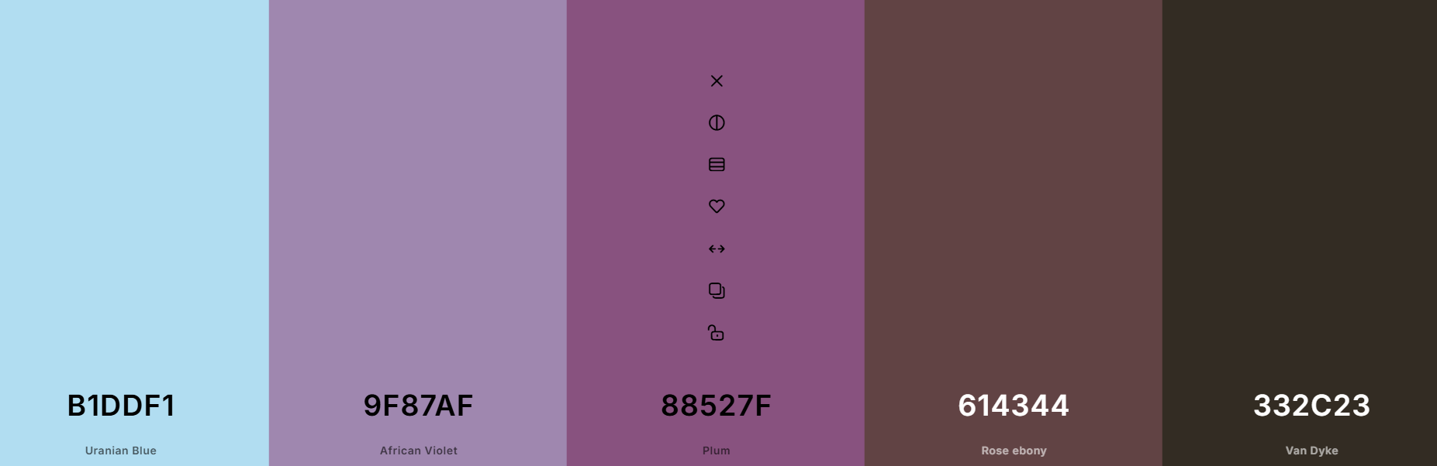
Website Design Process
Turning wireframe to design
  Color Scheme (coolors.co)

Slide 5
Wireframe Objectives
Clear visual hierarchy of websites elements
Consistent layout patterns across pages (skeleton)
Think it as a blueprint for your house construction
Bullet point before writing essay
Responsive Layout?
Monochrome
Notes:
Example:
LinkedIn

Slide 6
Wireframe Steps
Sketch
Grid / Layout (Section) – Header, main content, sidebar, footer
Content Block (placeholder for text and image)
Functionality – Buttons, filters, and forms
  Reduce eyes movement (place related information together)
  Reduce mouse movement (place related button together)
Rinse and Repeat (Refine)
Tools: Figma / wireframe.cc

Slide 7
Layout (Section)
Header (Logo / Nav / Search)
Hero (Main banner / CTA)
Main Content – Central section that holds most of your info
Sidebar (Filter / Mini sitemap / Links)
Footer (Contact Information / Sitemap / Social links)

Slide 8
Fold
Concept from newspaper industry
Above the fold
  Content that is visible before scrolling
  Your first impression
  Include CTA (like ‘Apply Now’)
Below the fold
  Content that is required to scroll
Bounce rate is when user never scroll down and left the page
Notes:
Question:
- What kind of information should always be above the fold?

Slide 9
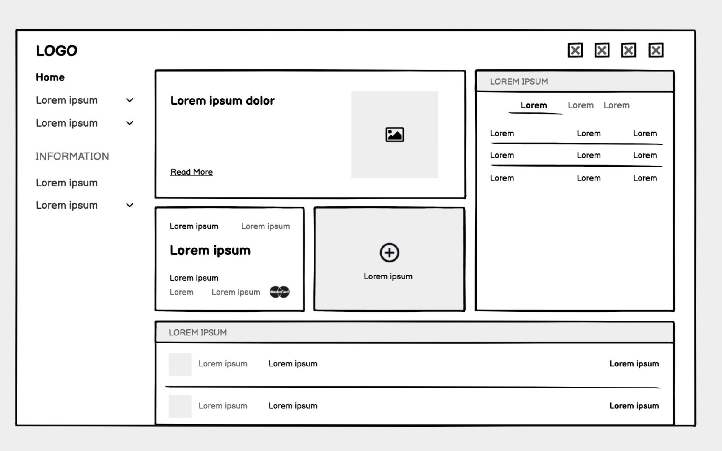
Wireframe Example
Notes:
Tip:
- Always test your wireframe with others before adding visuals – see if they understand where to click or look first

Slide 10
Storyboard
What is storyboard?
What is the difference between storyboard and wireframe?
Notes:
Wireframe: Focuses on the layout and structure of a single page or screen. It's a static blueprint of what elements go where.
Storyboard: Focuses on the sequence of interactions and the user's journey across multiple screens or states. It tells a story of how a user accomplishes a task, showing the transitions and changes in the interface over time.
Think of it this way: A wireframe is like a single floor plan of a room. A storyboard is like a series of comic panels showing someone walking through different rooms of a house, opening doors, and interacting with objects.

Slide 11
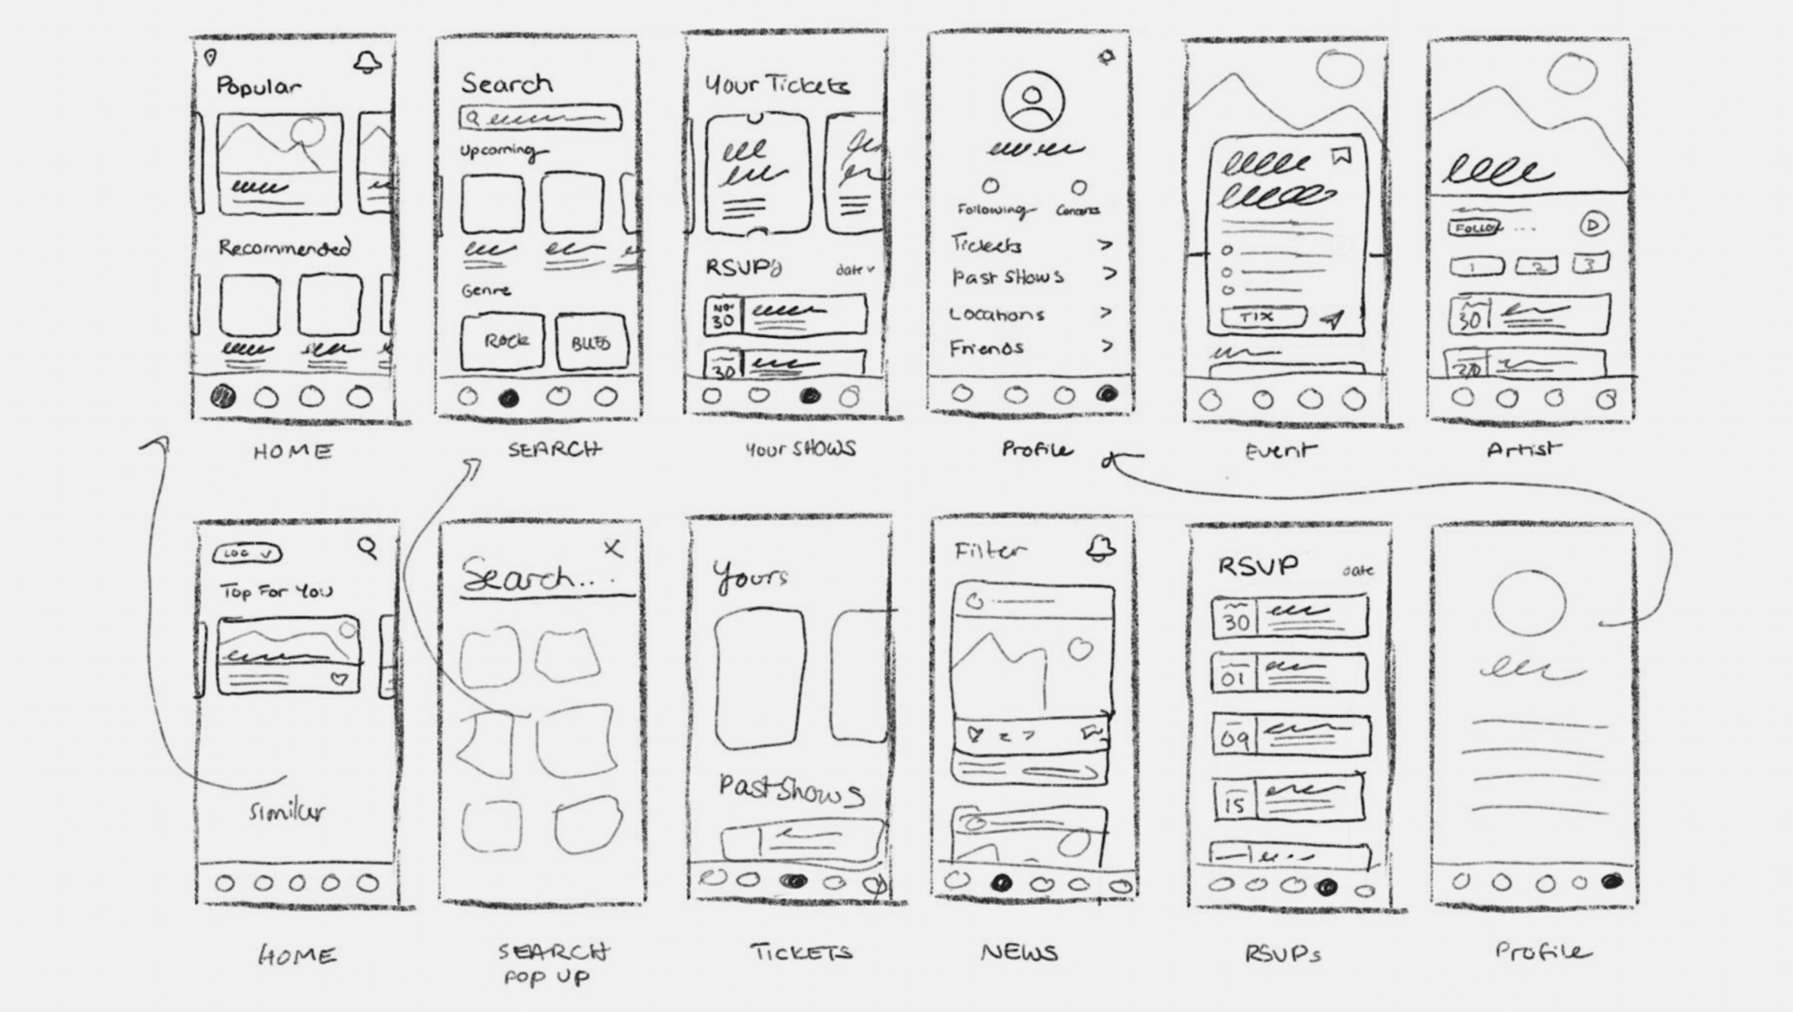
Storyboard Example

